Slide 1
2020-2024
CONSOLIDATED PLAN
ACTION PLAN
AND
NRSA (renewal)
Districts 1, 2, 5, 6, and 7
Virtual Meeting
Wednesday, September 2nd, 2020

Slide 2
OVERVIEW
CONSOLIDATED PLAN/ACTION PLAN
RESULTS FROM COMMUNITY SURVEYS
NRSA ACCOMPLISHMENTS
NRSA RENEWAL (New Boundaries)

Slide 3
Consolidated Plan & Annual Action Plan
Consolidated Plan – FY 2020-2024
Annual Action Plan FY 2020-21
City of Detroit receives annual U.S. HUD grants:
Community Development Block Grant (CDBG),
HOME Investment Partnership (HOME) Program
Emergency Solutions Grant (ESG),
Housing Opportunities for Persons with AIDS (HOPWA)
HUD plan requires us to identify and prioritize the City’s housing & community development needs and set five-year goals for use of grants
Input from diverse stakeholders such as residents, community leaders, non-profits, and private sector to create the plan
City’s application to HUD to receive annual allocation of HUD Grant funds
Identifies strategic projects and programs to be done using the annual HUD funding
Supports the strategies, goals, & objectives of the Consolidated Plan
Leverages private sector, state, and local general funds investment
FY 2020-21 Annual Action Plan is the 1st year of 5-yr Consolidated Plan

Slide 4
Consolidated Plan Strategy & Annual Action Plan
Five Year Plan
2020-2024
(Contains Strategies, broad goals, and objectives)
Plan to submit by Oct 15, 2020
Due: May 15, 2021
Action Plan
Year 1: 2020
(Contains specific implementing actions to carry out five year strategies, goals and objectives)
Action Plan
Year 2: 2021
(Contains specific implementing actions to carry out five year strategies, goals and objectives)
Action Plan
Year 3: 2022
(Contains specific implementing actions to carry out five year strategies, goals and objectives)
Action Plan
Year 4: 2023
(Contains specific implementing actions to carry out five year strategies, goals and objectives)
Action Plan
Year 5: 2024
(Contains specific implementing actions to carry out five year strategies, goals and objectives)
Goals
Primarily focused on low-to moderate-income households and communities
Development of decent and affordable housing
Create suitable living environments and promote quality of life
Expand economic opportunities

Slide 5
City of Detroit Funding Allocations 2005 – 2020

Slide 6
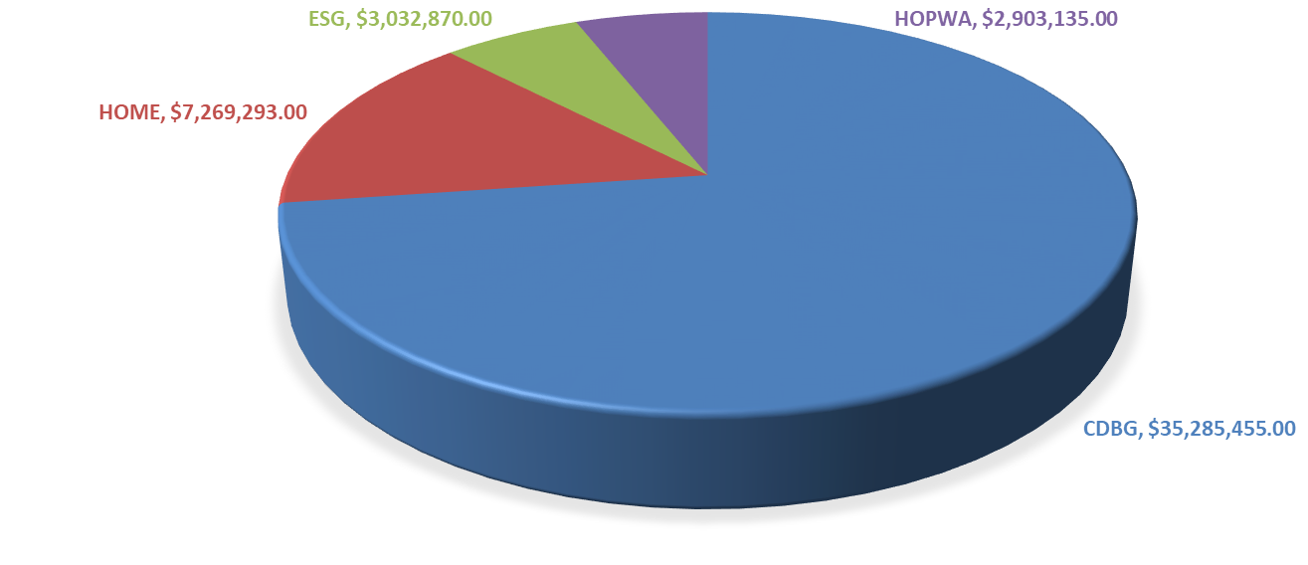
FY 2020-2021 Annual Action Plan Resources
Resources (1st Plan Year)
Actual appropriation from HUD for FY 2020-2021
Allocation of funding based on Consolidated Plan priorities, goals, and previous funding

Slide 7
COMMUNITY DEVELOPMENT BLOCK GRANT (CDBG)
Last 5-yr Activity Expenditure Budget
Admin/Planning | 31,640,753.00
Demolition | 15,718,907.00
Economic Development | 11,144,747.00
Home Rehabilitation (incl Lead) | 34,713,616.00
Public Improvements/Pre-dvpt Rehab | 4,465,417.00
Public Facility Rehabilitation | 6,461,074.00
Public Service | 34,411,373.00
Section 108 Loan Repayments | 26,309,868.00

Slide 8
LAST 5-YR ACTIVITY EXPENDITURE BUDGET (CDBG)
Admin/Planning | 31,640,753.00
Demolition | 15,718,907.00
Economic Development | 11,144,747.00
Home Rehabilitaion (incl Lead) | 34,713,616.00
Public Improvements/Pre-dvpt Rehab | 4,465,417.00
Public Facility Rehabilitation | 6,461,074.00
Public Service | 34,411,373.00
Section 108 Loan Repayments | 26,309,868.00

Slide 9
Identify & Prioritize Housing & Community Dev Needs
The City’s housing and community development needs were identified and prioritized below using a combination of online community needs surveys and analysis of demographic, housing, and economic data:
Housing
Economic Development
Public Infrastructure and Neighborhood Services
Community and Public Facilities
Public Services
Homeless Prevention

Slide 10
Priority Area #1: Housing
Community Needs Assessment Conclusions:
  Owner Occupied Home Repair (67% High Need)
  Affordable Single-Family Rental Housing (63% High Need)
  Affordable Multi-Family Housing (63% High Need)
Data Analysis Conclusions:
  Nearly 45 % of all households are housing cost burdened
  Detroit’s housing stock is primarily single family
  Detroit’s older housing stock makes for poor housing conditions
  Lower incomes makes housing less affordable
  Existing homeowners are unable to get home repair loans

Slide 11
Priority Area #2: Economic Development
Community Needs Assessment Conclusions:
  Employment Training (76% High Need)
  Job Creation/Retention (73% High Need)
  Start-Up Business Assistance (58% High Need)
Data Analysis Conclusions:
  Education drives job access and income
  Only 12 % of Detroit residents earned a Bachelor’s or higher degree
  High unemployment rates.
  High poverty rates, concentrations across many neighborhoods.
  Many jobs in Detroit are not filled by resident workers.
  Detroit residents commute outside of City for jobs

Slide 12
Priority Areas #3&4: Public Infrastructure & Facilities
Community Needs Assessment Conclusions:
  Water/Sewer Improvements (69% High Need)
  Street and Sidewalk Improvements (65% High Need)
  Demolition of Substandard Structures (65% High Need)
  Youth Centers (68% High Need)
  Child Care Centers (63% High Need)
  Community Centers (61% High Need)
Data Analysis Conclusions:
  The City combats blight but there are 80,000+ vacant housing units.
  In 2014, an estimated 40,077 structures were blighted
  The city demolished 13,487 structures between 2014 and 2018
  Youth and Community Centers provide stability
  Detroit has 15 Community Centers
  Detroit working on several neighborhood plans

Slide 13
Priority Area #5: Public Services
Community Needs Assessment Conclusions:
  Mental Health Services (72% High Need)
  Transportation Services (70% High Need)
  Fair Housing (66% High Need)
  Homeless Services (67% High Need)
  Youth Activities (66% High Need)
Data Analysis Conclusions:
  Detroit’s senior population is growing
  Aging population is attributed to a rise of residents with disabilities
  46% or 38,499 individuals 65+ have a disability
  Disabled individuals are 20% of the population (135,689 individuals)
  New instances of HIV/AIDS cases are decreasing

Slide 14
Priority Area #6: Homeless Prevention
Community Needs Assessment Conclusions:
  Support Services for Homeless Prevention (72% High Need)
  Emergency Support Services (70% High Need)
  Emergency Shelters for Homeless Persons and Families (69% High Need)
  Permanent Housing (69% High Need)
Data Analysis Conclusions:
  From 2015 to 2019 the homeless population decreased by 23%.
  Chronically homeless population increased by 31%.
  The City targets resources to homeless individuals and families most in need.

Slide 15
Neighborhood Revitalization Strategy Areas (NRSAs)
Targeted neighborhood investment of CDBG funding. No additional $$
Attracts and leverages private sector and other government funding
Designation approved by HUD. Five NRSAs approved in 2015.
City of Detroit requesting extension of NRSA approvals
Benefits
  LMI Job Creation/Retention - Eliminating the need for income tracking
  Aggregation of Housing – Furthers mixed income funding of home repair
  Aggregate Public Benefit Standard Exemption - Special Economic Development activities in NRSA may be exempt from certain job standards
  Public Service Cap Exemption – Allows increased public services funding in the NRSAs by a Community Based Development Organization (CBDO)

Slide 16
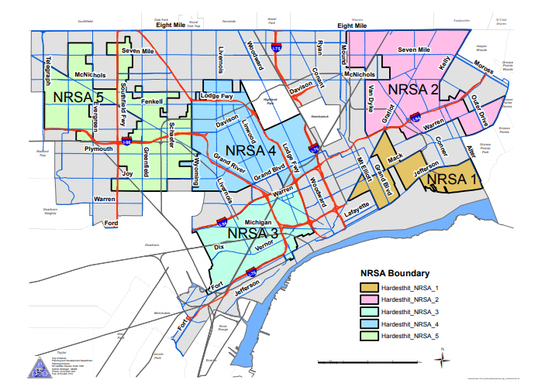
2015-2019 NRSAs

Slide 17
NRSA Accomplishments from 2015-2019
Improved Housing
Neighborhood Stabilization
Small Business Support
Job Creation
Public Services
  Total number of houses repaired under the 0% Loan Program were 515 owner occupied units. Of that, 335 units were completed in NRSAs.
  139 residents received Senior Emergency Repair program grants - $3MM in CDBG funds
  128 people were served with the Lead Abatement program - over $2MM in CDBG funds
  9,223 residential demolitions were completed in NRSAs
  344 commercial demolitions were completed in NRSAs
  263 businesses were assisted that were located within the NRSAs
  321 property owners addressed exterior violations
  50 businesses received technical assistance to help advance business ideas
  Over 15,000 Detroit youth received employment preparation City Wide
  281 adults were placed in permanent jobs and over $1MM in CDBG funds spent to support job placement
  Home repair loan applicants who were denied received CWF services such as financial counseling & credit repair
  4,027 youth received summer jobs and over $5MM in CDBG funds spent
Notes:
In total, 515 owner occupied units were repaired under the 0% Loan Program which made up approximately $6.2M in funding. Of the $6.2M, approximately $3.1M was CDBG funding.

Slide 18
Criteria for 2020-2024 NRSAs
2015-2019 NRSA strategy improved neighborhoods and attracted investments
New NRSAs selected based on:
Neighborhoods within the NRSA must be contiguous
70% of the population of the NRSA must be low-income households
Use of new census bureau data resulted in changes in boundaries
Use of previous NRSAs as starting point
NRSAs must be “primarily residential” (60%)
Overlap with other investment areas: Strategic Neighborhood Fund (SNF) Affordable Housing leverage Fund (AHLF), CBDO areas, Choice Neighborhoods, and Housing Resource Centers (HRC)
Notes:
The City used the most up-to-date demographic data provided by HUD to analyze previous 2015-2020 NRSA boundaries and used these boundaries as a starting point. Some boundaries that were approved previously under the NRSA plan no longer qualified due to a shift and increase in area median income.
The City overlapped the new boundaries and then expanded these boundaries to include the SNF neighborhoods, which is proposed to leverage approximately $171M and will result in demolition, streetscape improvements, parking improvements and commercial façade and other corridor improvements. In addition to this, the City also wanted the current Community Based Development Organizations that are certified with the City and Housing Resource Centers to be represented in the proposed NRSA boundaries. The addition of these programs will give the City the opportunity to leverage over $700MM City-Wide in additional funding, both private and federal.

Slide 19
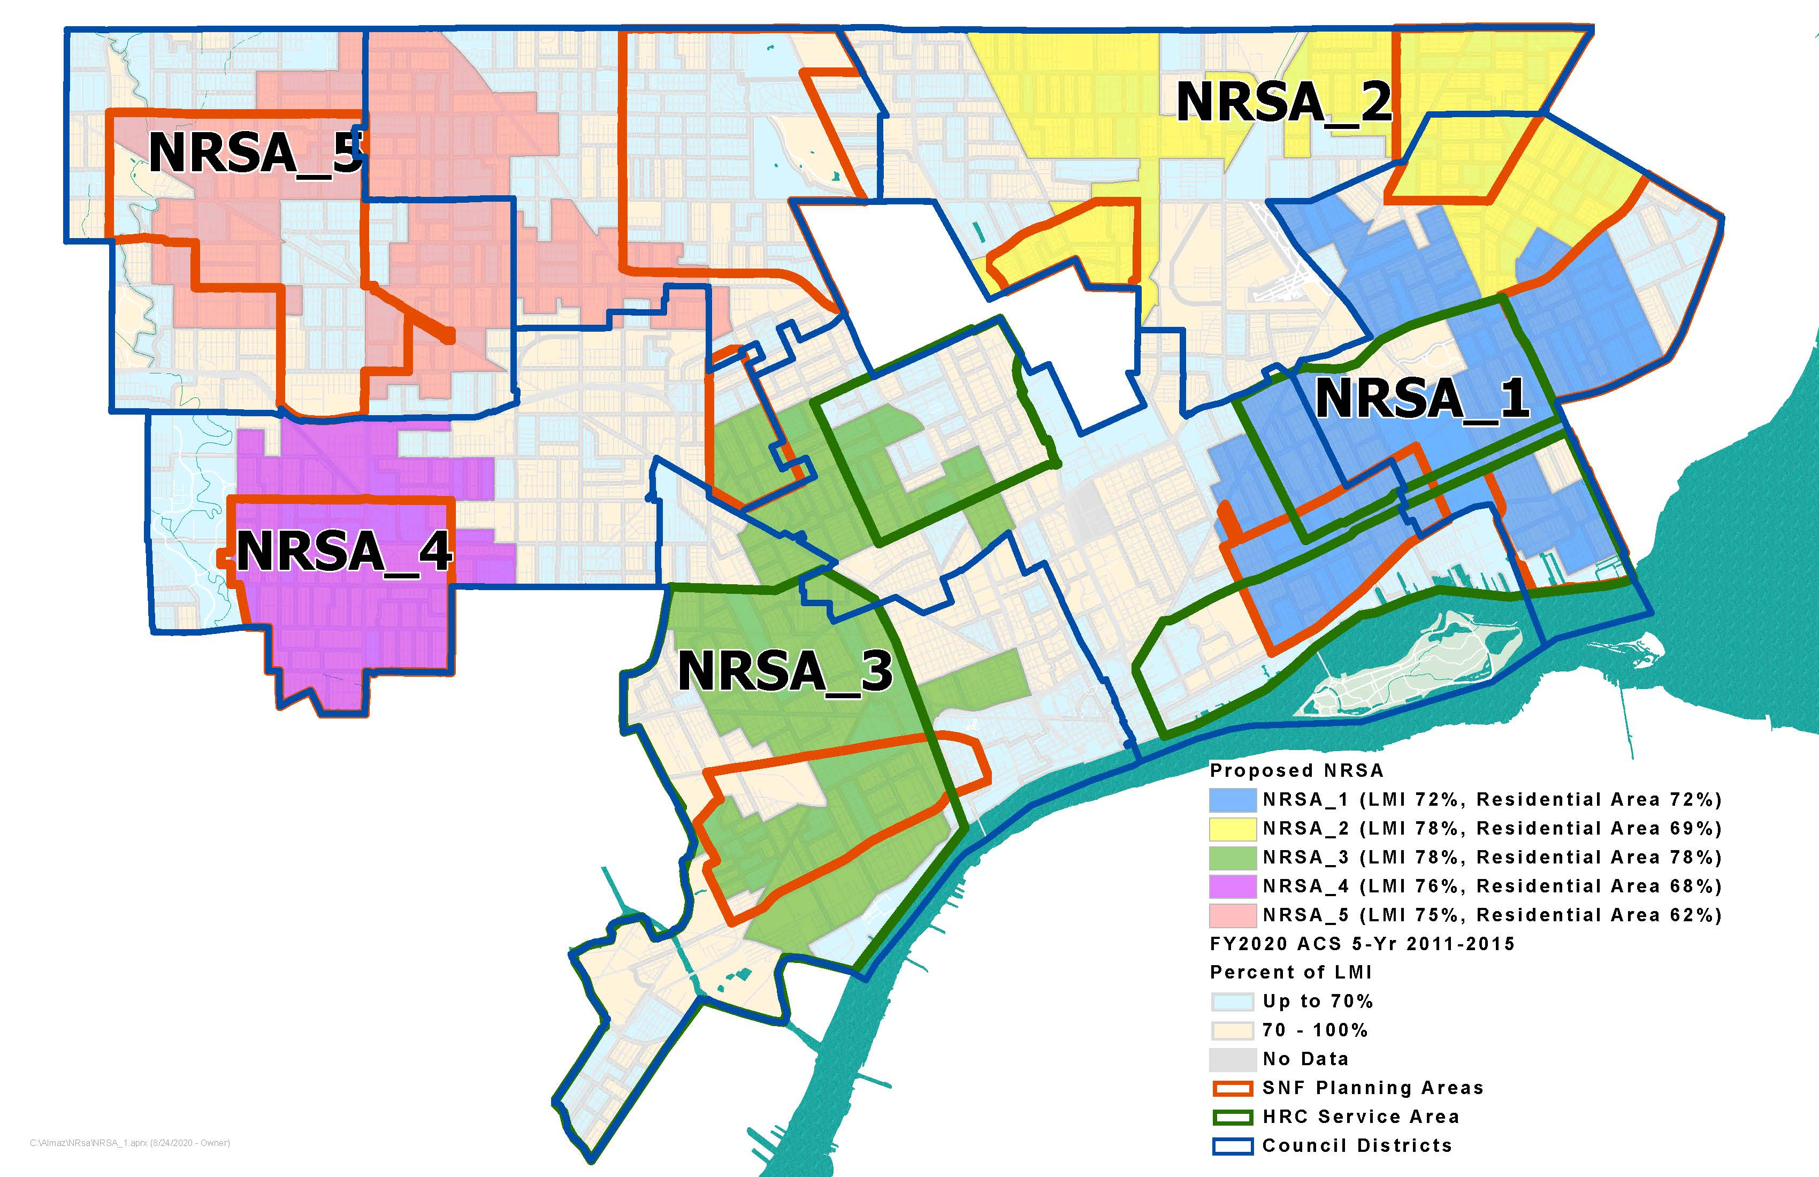
Proposed New 2020-2024 NRSAs

Slide 20
Strategies for 2020-2024 NRSAs
Improved housing – home repair loans, emergency repair grants, and lead abatement grants
Neighborhood stabilization - residential and commercial demolition
Small business support – financial and technical assistance, commercial façade improvements
Job creation/retention - workforce development, jobs
Public services – youth summer jobs, family income and wealth building

Slide 21
Public Participation
Question and Answer
Comments

